Slide 1
Planning Your Final Year Project (Joe Appleton)

Slide 2

A Scientific Project
Logical: Inferences must be based on logical principles of reasoning
Empirically Tested: Inferences derived must match with observed evidence
Repeatable: I should be able to pick up your work and repeat what you have done. Ideally we should get the same results

Slide 3
Plan Your Project
“A well planned out project will logically flow. It leads the reader to clear conclusions that are derived from carefully thought out data collection methods. The methods allow for a given research question or hypothesis to be answered. In turn, the hypothesis or research question would have been developed to explore or solve an interesting problem statement. “

Slide 4
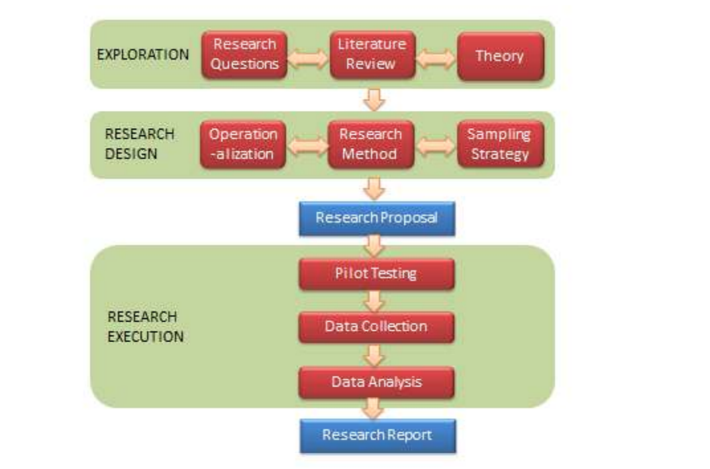
Research Must Be Designed
Problem statement | The problem you are trying to solve. You should provide evidence that the problem exists
Literature Review | Allows you to place your study in the context of the wider scientific body of work.
Research Questions or Hypotheses | Should allow you to address the problem statement
Methodology | The tools and techniques used to manage the project and gather key pieces of data that will allow for logical and reasoned responses to the research question or hypotheses.

Slide 5
Problem Statement

Slide 6
The Key Points to Consider
Identify a problem
- That you find interesting
- You can align to the wider literature
Provide clear evidence that the problem exits
In what setting have you observed the problem
Articulate how the research will address the problem

Slide 7
A Example Project Problem Statement
In the United Kingdom, it has been estimated that scamming causes up to £10 billion worth of damage every year (Lonsdale et al. 2016). […]
University students in particular are faced with a variety of scams which can have devastating effects, considering students are less likely to verify online information compared to people who are not students (Metzger, Flanagin and Zwarun 2003). […]
This study explores the use of a Progressive Web Application to raise student’s awareness about the latest and most common scams that students are faced with.

Slide 8
Do not be too ambitious. You only have a limited amount of time. Be realistic about what can be achieved in this period
Ensure you do not select a demographic that is too broad (e.g. All social media users)
Attempt to make a commercial product. Such an endeavor does not align with an academic project and is beyond the scope of what can be achieved.
Common Problems

Slide 9
Literature Review
Critically appraising and interpreting literature that relates to your research topic.

Slide 10
Why conduct a literature review
Aligning your research against a backdrop of wider studies
Allowing you to make informed methodological and design choices
Hones your ability to handle and critically analyse large amounts of information

Slide 11
Ensure you use good quality sources

Slide 12
Research Question/Hypothesis

Slide 13
A hypothesis is in effect a educated guess about some measurable outcome such as efficiency. An example hypothesis could be:
A soft network implementation in a university lab is more efficient than its hardware equivalent
What Makes a Good Hypothesis

Slide 14
Specific bounded and answerable and open
How can I create a progressive mobile application using Google Firebase in order to assists higher education students with referencing?
What Makes A Good Research Question

Slide 15
Methods

Slide 16
For Your Final Year Project - Methods Can Be Split Into Two Areas
Process
Evaluative
User Feedback
Tools
Data Collection
Project Management
Benchmarking
Development Tools
Dev Ops
Performance Testing
Measuring
Version Control
Feedback

Slide 17
A Quick A-Side About Process Methods
This is Bad, Don’t Talk About Team Methods (Waterfall, Agile, Spiral)
Instead, adapt these common software methodologies to create a simple process that works for an individual
User Feedback
“The author has investigated and analysis different methodologies that could be deployed for this project (See Appendix A). Base on that analysis, the waterfall methodology was chosen as the best methodology suitable for this project…” - (Networking Student 2018, p.38)
Benchmarking

Slide 18
EVALUATATIVE METHODS TAKE AWAY THE GUESSWORK THEY MEASUE
“Recording and reporting observations in sufficient detail to enable other scientists to replicate the study. In this way we determine if what has been observed is true” (Langley 2007 p.3)
Langley J. (2007). On the importance of methods. Injury Prevention, 13(4), 218.

Slide 19
There are Three Broad Evaluative Methods
Qualitative
Quantitative
Mixed (Both Qualitative and Quantitative)
User Feedback
Benchmarking

Slide 20
Request per Second (WEB)
System Load Average
Memory usage
Response Time (WEB)
Number of function calls
Run Time
Latency
…. Many More
Olanrewaju, R.F., Islam, T. and Ali, N., 2015. An empirical study of the evolution of php mvc framework. In Advanced Computer and Communication Engineering Technology (pp. 399-410). Springer, Cham.
Human Quantitative Methods
User Feedback

Slide 21
Surveys
Focus Groups
Case Studies
Heat Maps
…Many More
.
Qualitative Methods
Chen, Y.C., Hwang, R.H. and Wang, C.Y., 2012. Development and evaluation of a Web 2.0 annotation system as a learning tool in an e-learning environment. Computers & Education, 58(4), pp.1094-1105.

Slide 22
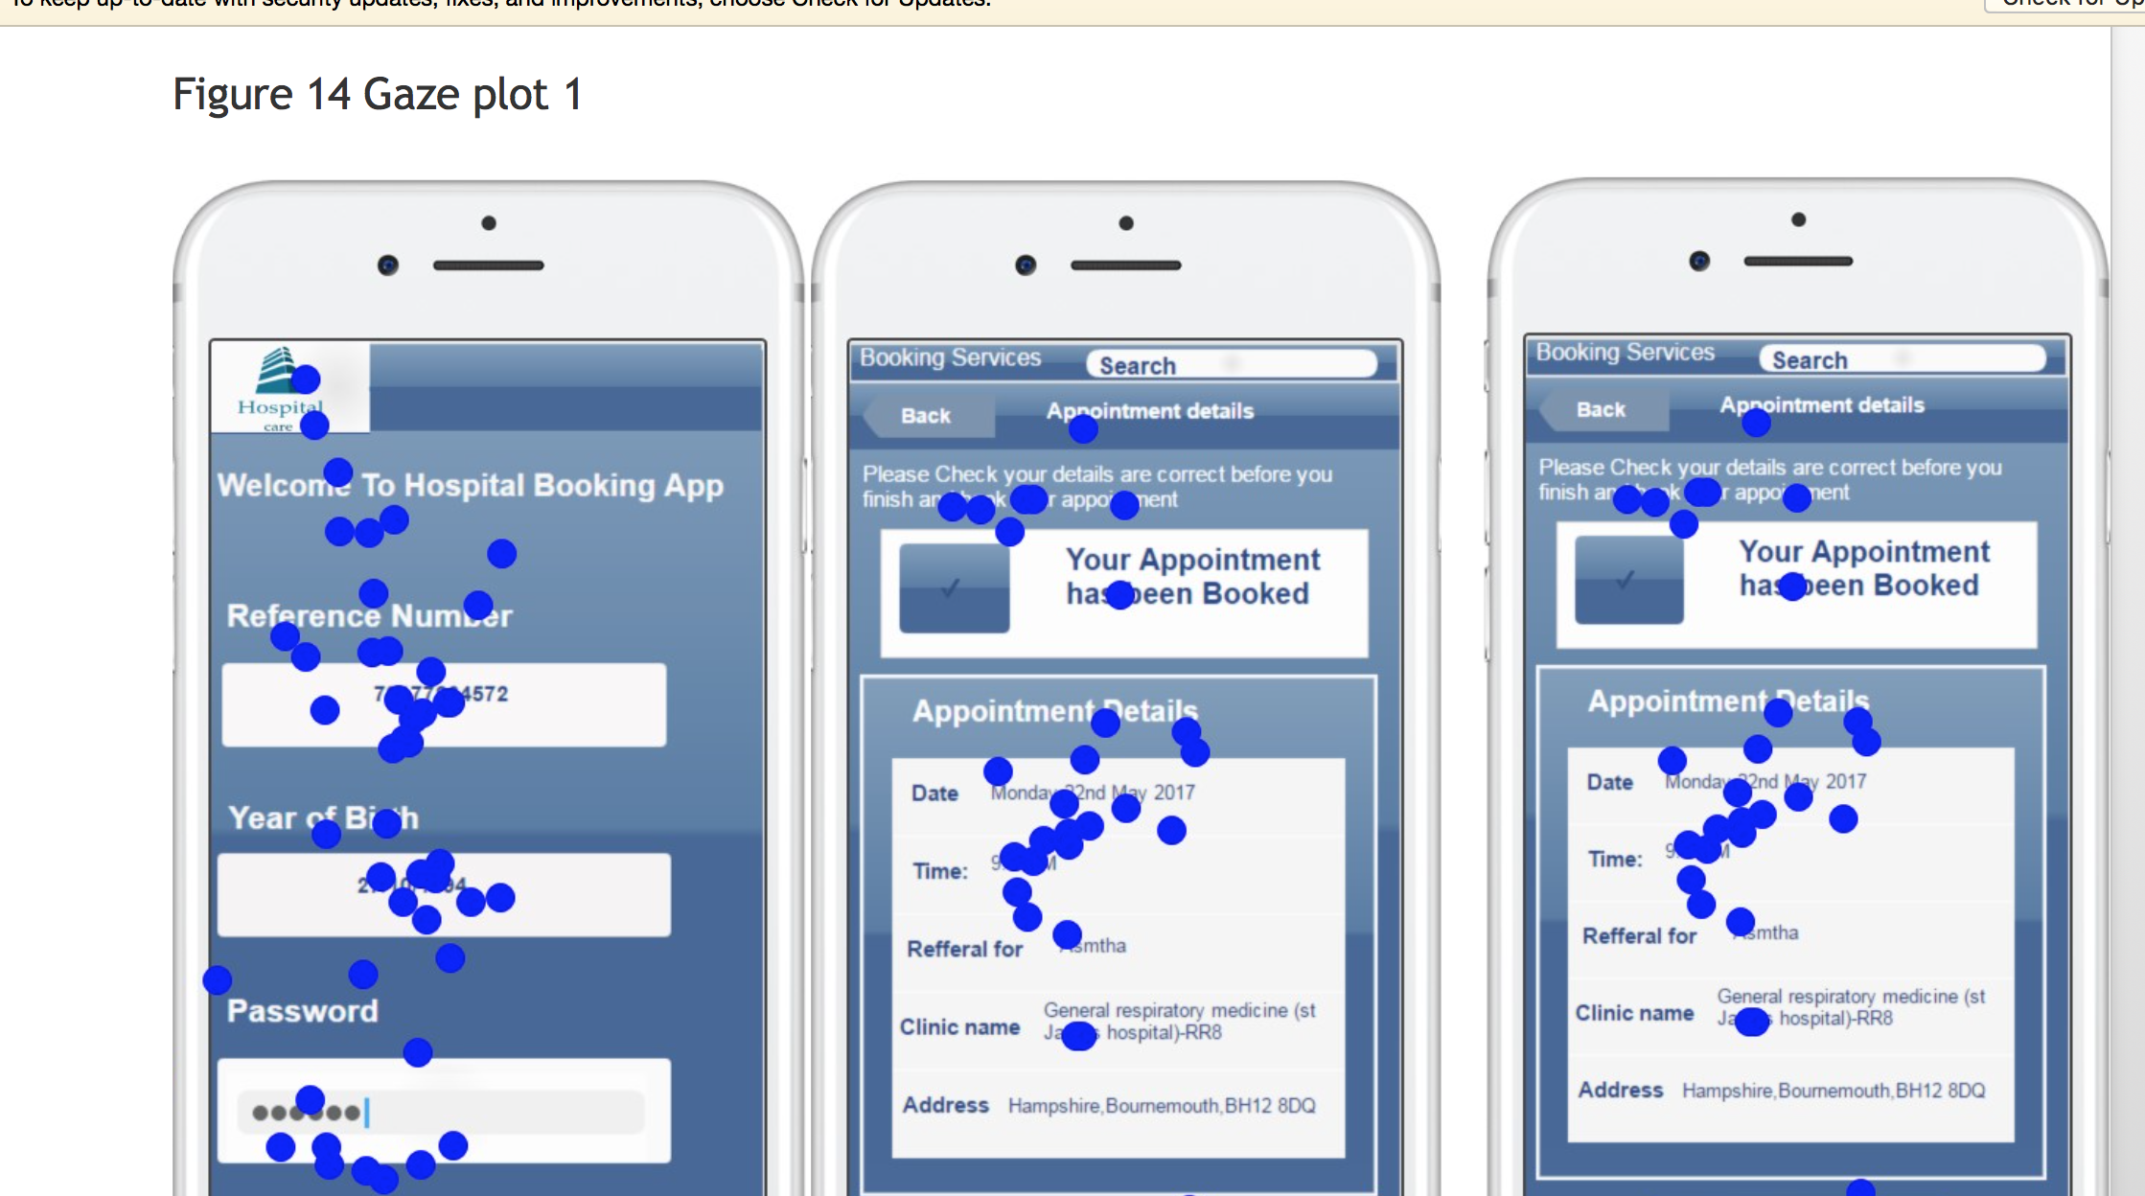
.
A Final Word Of Warning
Don’t pick methods because they are easily available, but may serve little to no value

